Slide 1
Bayesian Belief Networks
Dr.E.Sivasankar, NIT,Tiruchirappalli-15

Slide 2
Bayesian Belief Networks- Definition
A BBN is a special type of diagram (called a directed graph) together with an associated set of probability tables.
The graph consists of nodes and arcs.
The nodes represent variables, which can be discrete or continuous.
The arcs represent causal relationships between variables.

Slide 3
Bayesian Belief Networks- features
BBNs enable us to model and reason about uncertainty.
BBNs accommodate both subjective probabilities and probabilities based on objective data.
The most important use of BBNs is in revising probabilities in the light of actual observations of events.

Slide 4
Bayesian Belief Networks
Bayesian Network is a very important tool in understanding the dependency among events and assigning probabilities to them thus ascertaining how probable or what is the chance of occurrence of one event given the other.
For example, suppose you are getting scolded at school by your teacher for being late and there could be many reasons for being late like waking up late, traffic jams, etc.
So here, scolding is dependent on the events like waking up late or traffic jam i.e., these reasons have a direct influence on you being scolded.
This can be efficiently represented using Bayesian Network

Slide 5
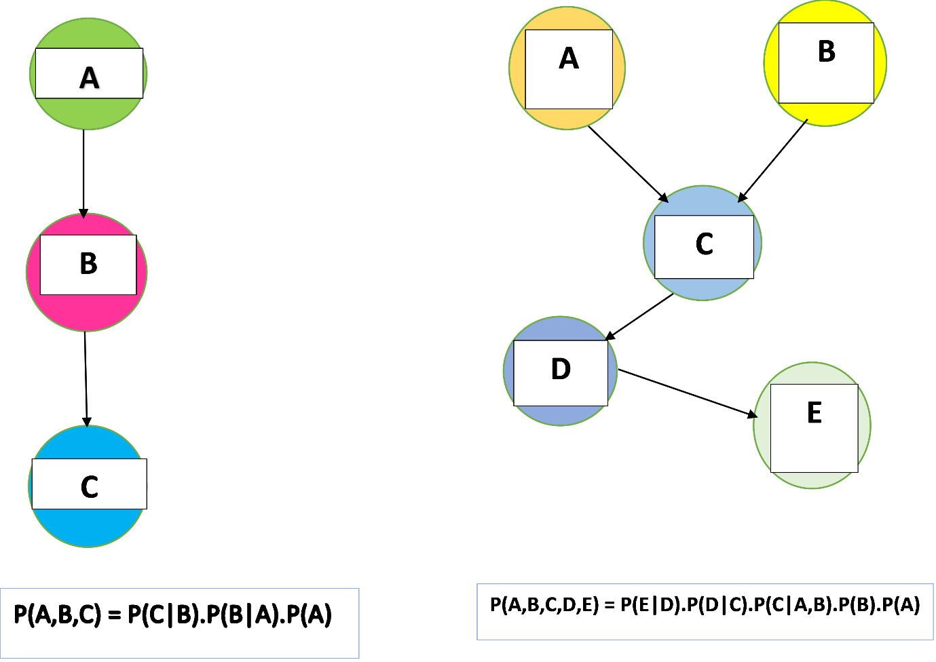
Bayesian Belief Networks

Slide 6
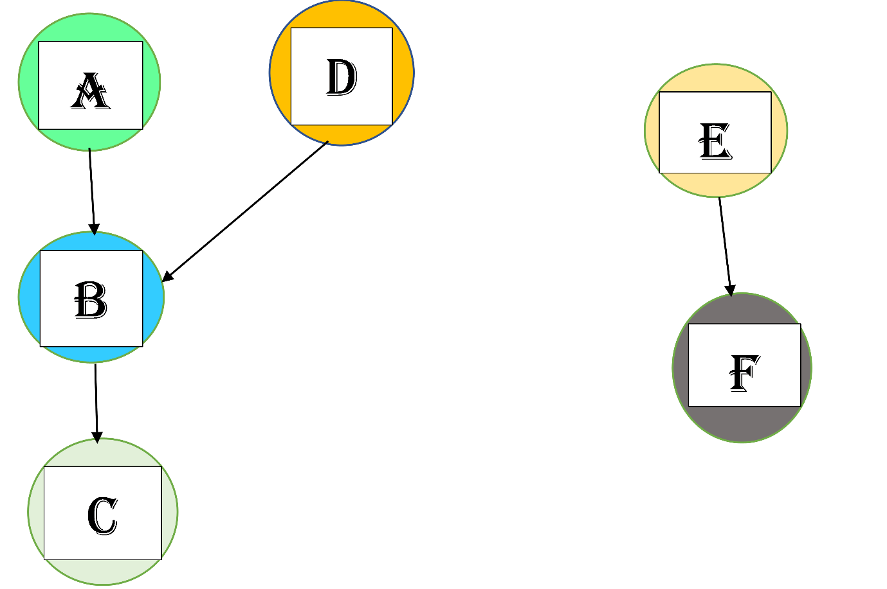
Real-World Example of Bayesian Network Model
Let, P(A) denotes the event that you wake up late in the morning.
P(B) denotes the event you are late for school.
P(C) denotes the event you are scolded by your teacher.
P(D) denotes the event there is a traffic jam on the road
P(E) denotes the event your father boards the public bus every morning.
P(F) denotes the event your father goes to office.

Slide 7
Real-World Example of Bayesian Network Model
So what is the probability that you are scolded at school? Now, you can easily find that out using the formula. So the final result becomes
P(C|B).P(B|A,D).P(D).P(A)
What about P(E) and P(F) ??? They are also present there in the model. Remember, two events which are not connected with each other with arcs directly or indirectly given any other node are called independent events and occurrence of one has no effect on the occurrence of another.

Slide 8
Real-World Example of Bayesian Network Model
We can safely predict from the model the value of P(C|F) i.e., the probability you being scolded because of the event that your father is going to office is 0.

Slide 9



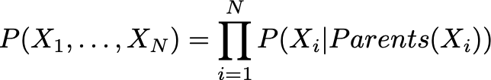
Mathematical Definition of Belief Networks
Conditional probability is the probability of a random variable when some other random variable is given. It is shown by
If these two random variables are dependent,
If they are independent, then
Mathematical Definition of Belief Networks
The probabilities are calculated in the belief networks by the following formula

Slide 10
Probability Axioms

Slide 11
Probability Distributions

Slide 12
Joint Events

Slide 13
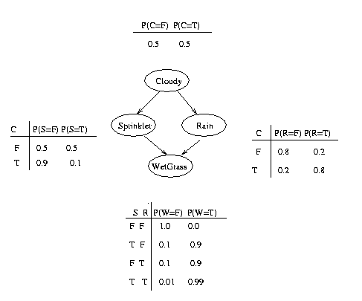
Joint Events
For example, consider the water sprinkler network, and suppose we observe the fact that the grass is wet. There are two possible causes for this: either it is raining, or the sprinkler is on. Which is more likely? We can use Bayes' rule to compute the posterior probability of each explanation (where 0==false and 1==true).

